Slide 1
Coagulation Mini-Study
Kyla Bauman

Slide 2
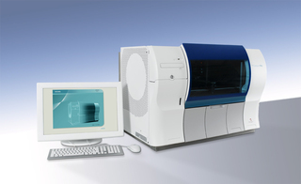
STAGO ANALYZER
Coagulation analyzer
PT, PTT, Fibrinogen, D-dimer, Heparin Xa
Methodologies Used:
  Viscosity-based (mechanical) detection system
  Immunoturbidometric
  Colorimetric Assay

Slide 3
STUDY OBJECTIVE
Manufacturer’s Instructions for reagents are timely and unnecessary
  Refrigerated reagent rack
Poses a risk for potentially delaying patient care
  Incident during stat situation
Study Objective: Correlate results obtained using reagent that was allowed to come to room temperature, versus reagent that was loaded cold (directly from the refrigerator).

Slide 4
ACCEPTANCE CRITERIA
ANALYTE | R Value > | Slope =/- | Medical Director’s TEa
PT | 0.95 | 0.1 | Within 5%
PTT | 0.95 | 0.1 | Within 8%
Fibrinogen | 0.95 | 0.1 | Within 10%
D-Dimer | 0.95 | 0.1 | Within 20%
Anti-Xa | 0.95 | 0.2 | Within 15%

Slide 5
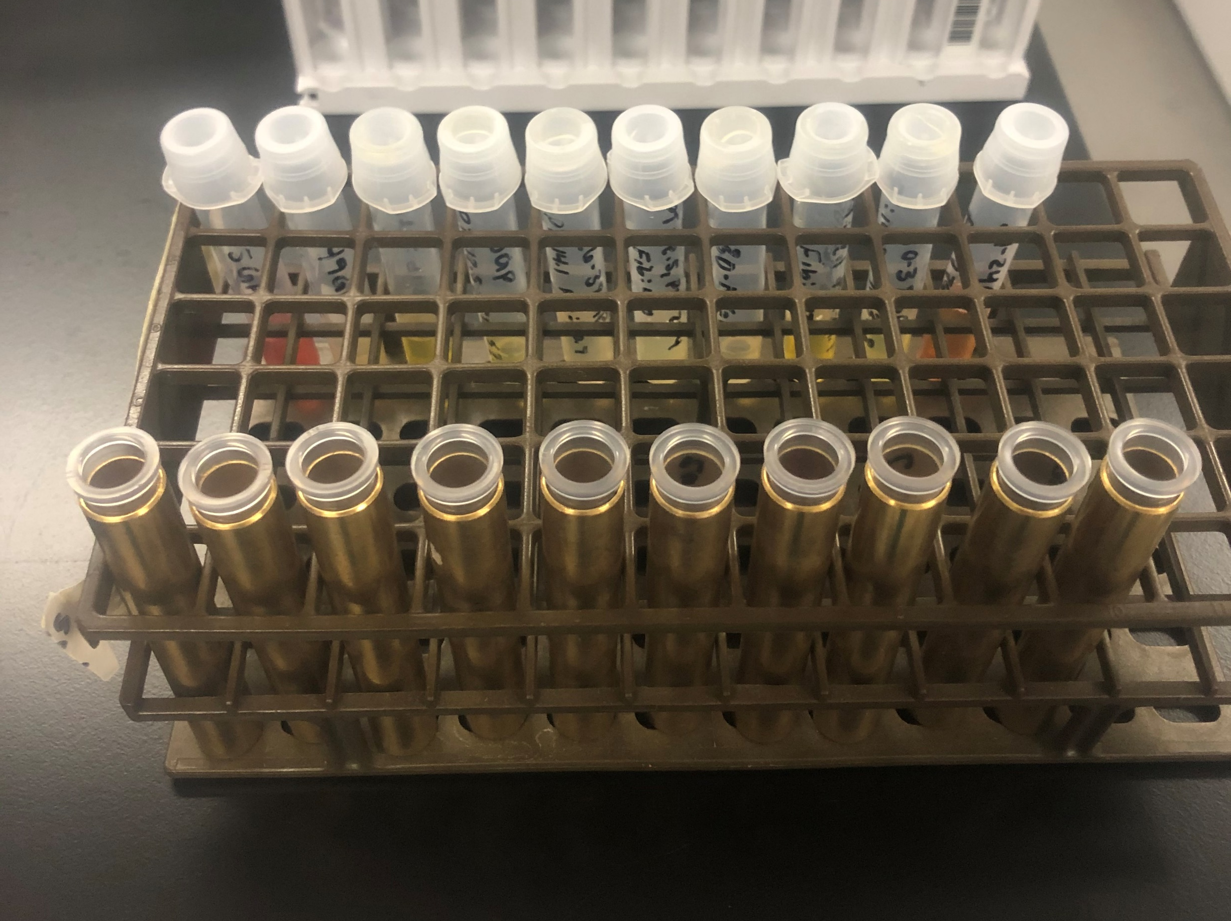
PROCEDURE OUTLINE
Collect sample pool
  20 Samples per analyte
  Split between each analyzer
  High, Normal, and Low values
2 sets of reagent were prepared
  Room temperature (RT)
  Refrigerated (COLD)
Each analyte was tested using either RT reagent or COLD Reagent
  On each analyzer

Slide 6
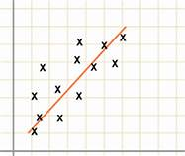
REGRESSION LINE REVIEW
The data was printed and transferred to a spread sheet
Programmed calculations were made
Criteria review to follow
  R value
  Slope
  Total Allowable Error

Slide 7
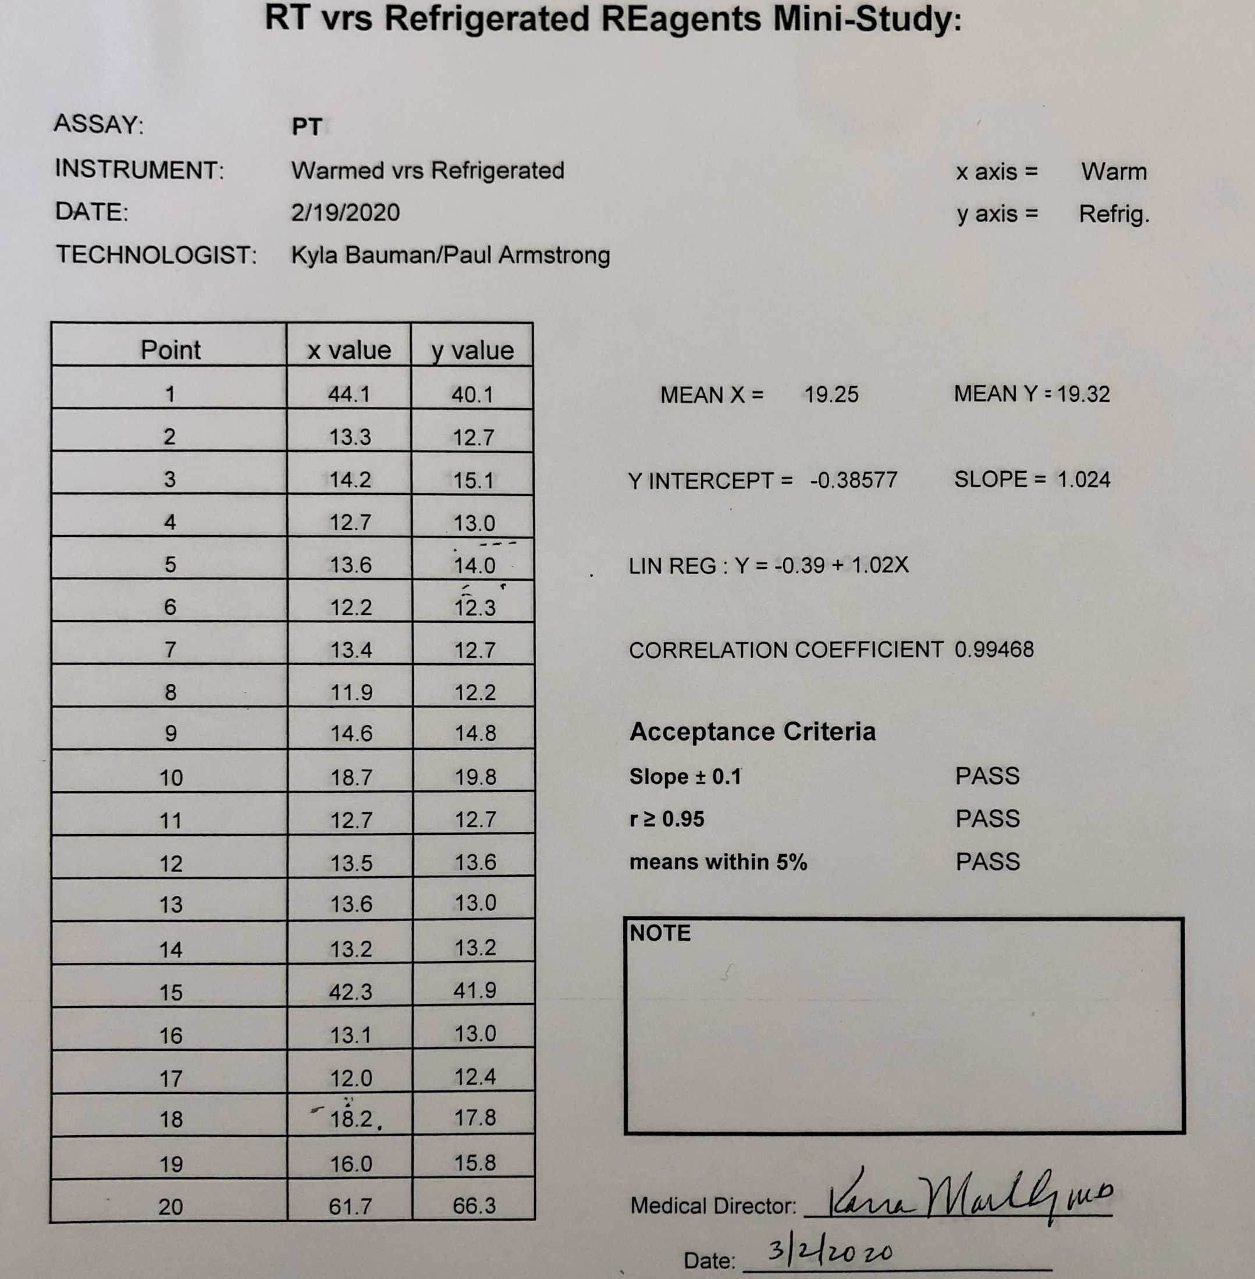

Protime Results
Acceptance Criteria PASSED

Slide 8
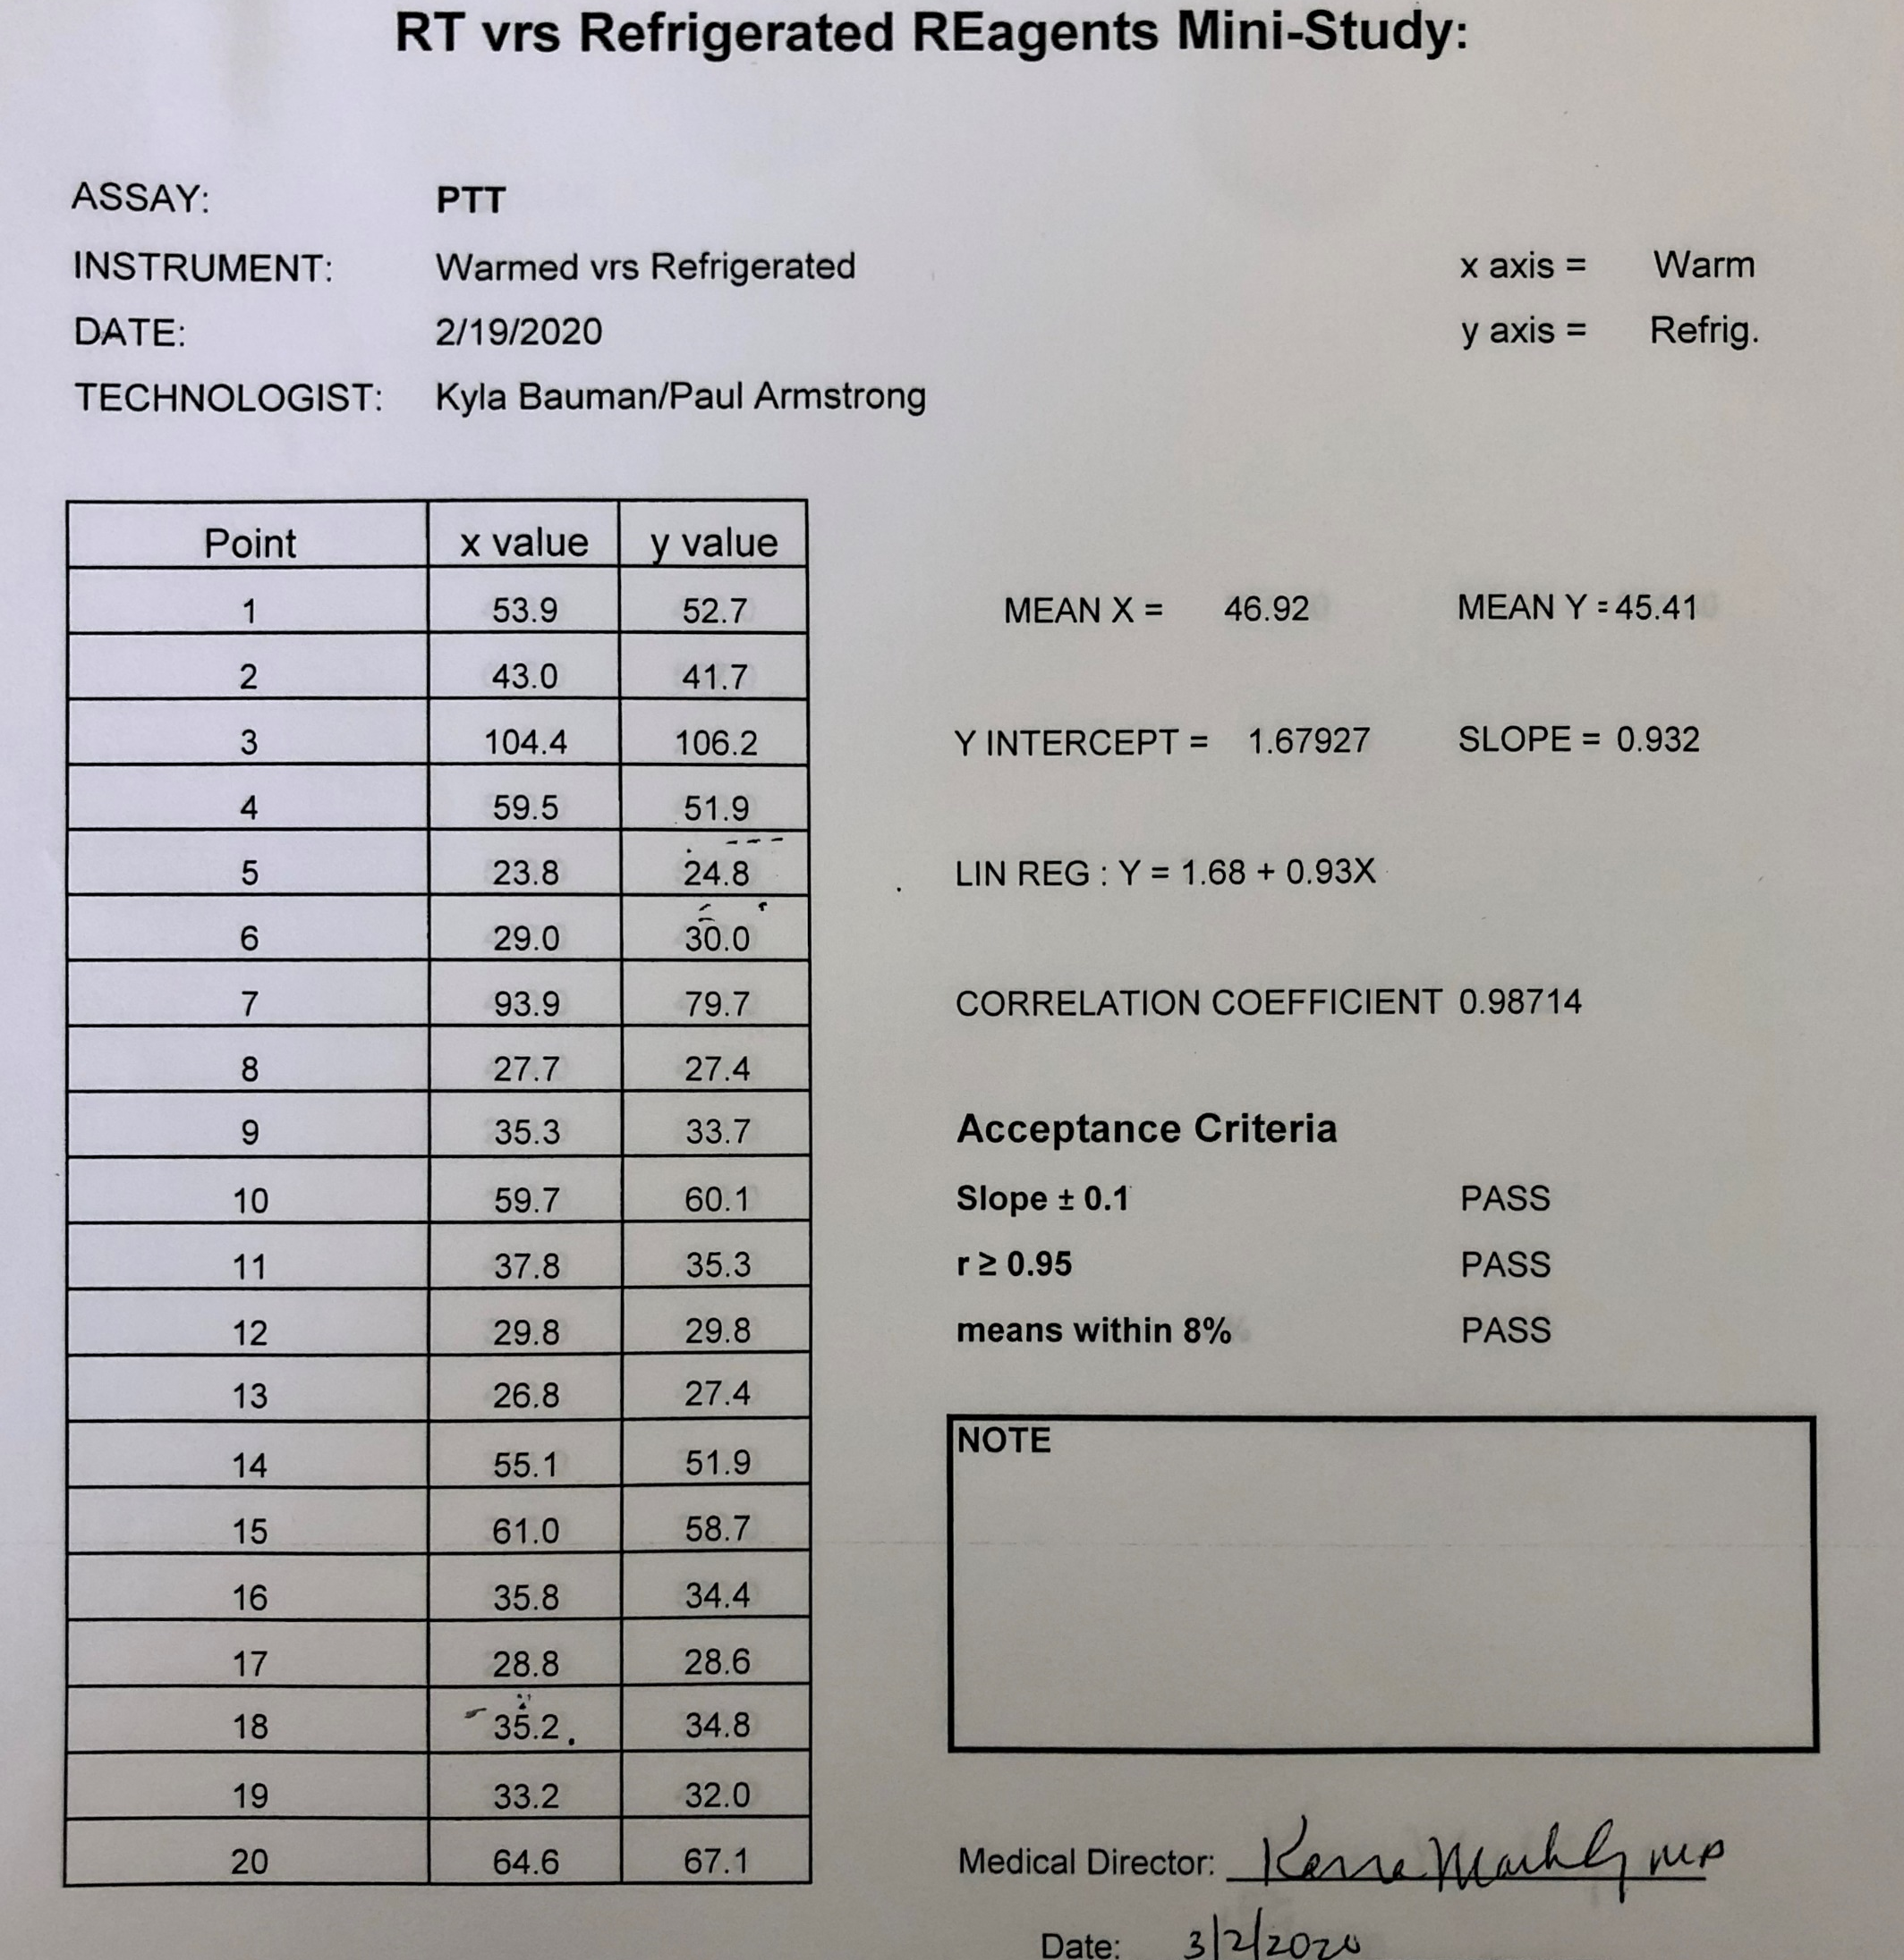

PTT Results
Acceptance Criteria PASSED

Slide 9
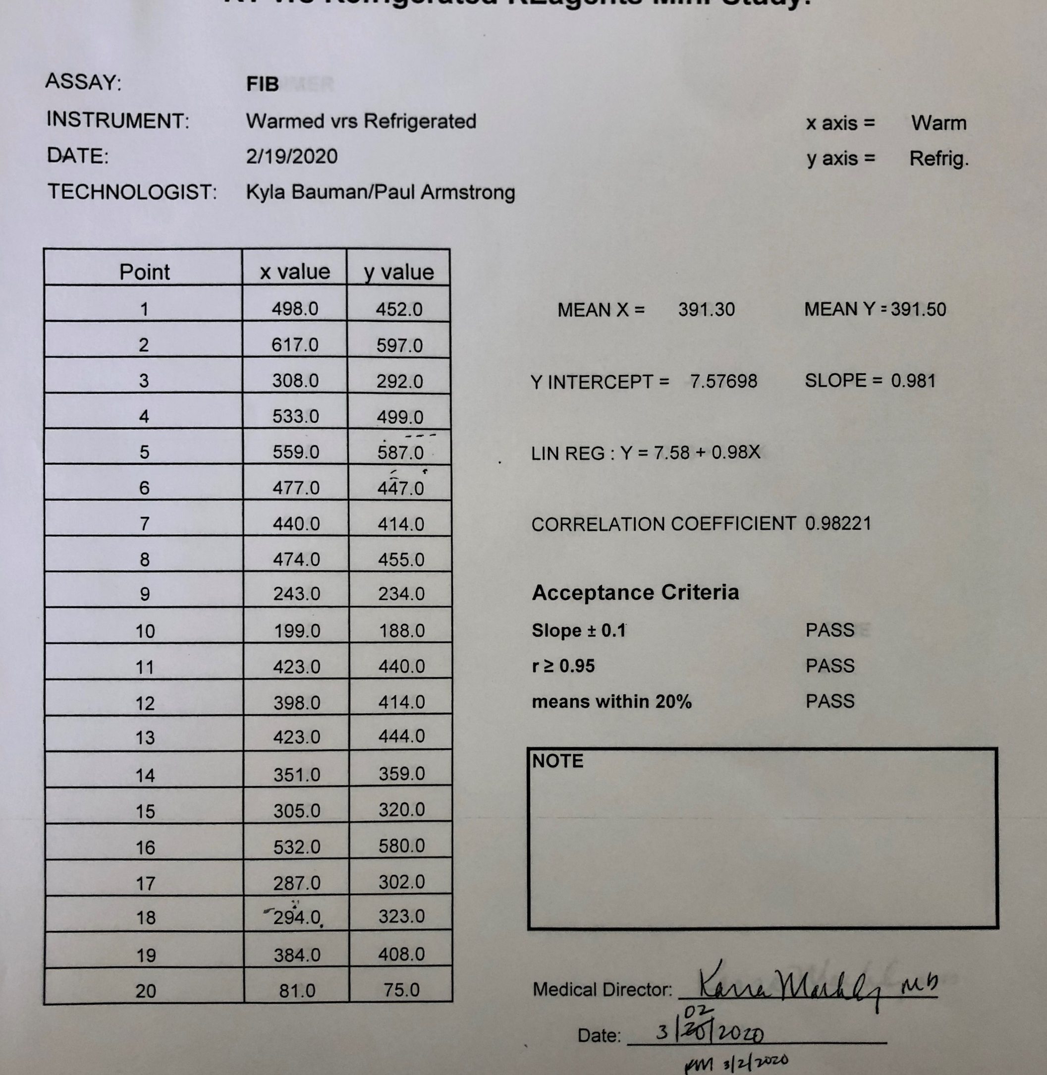

Fibrinogen Results
Acceptance Criteria PASSED

Slide 10
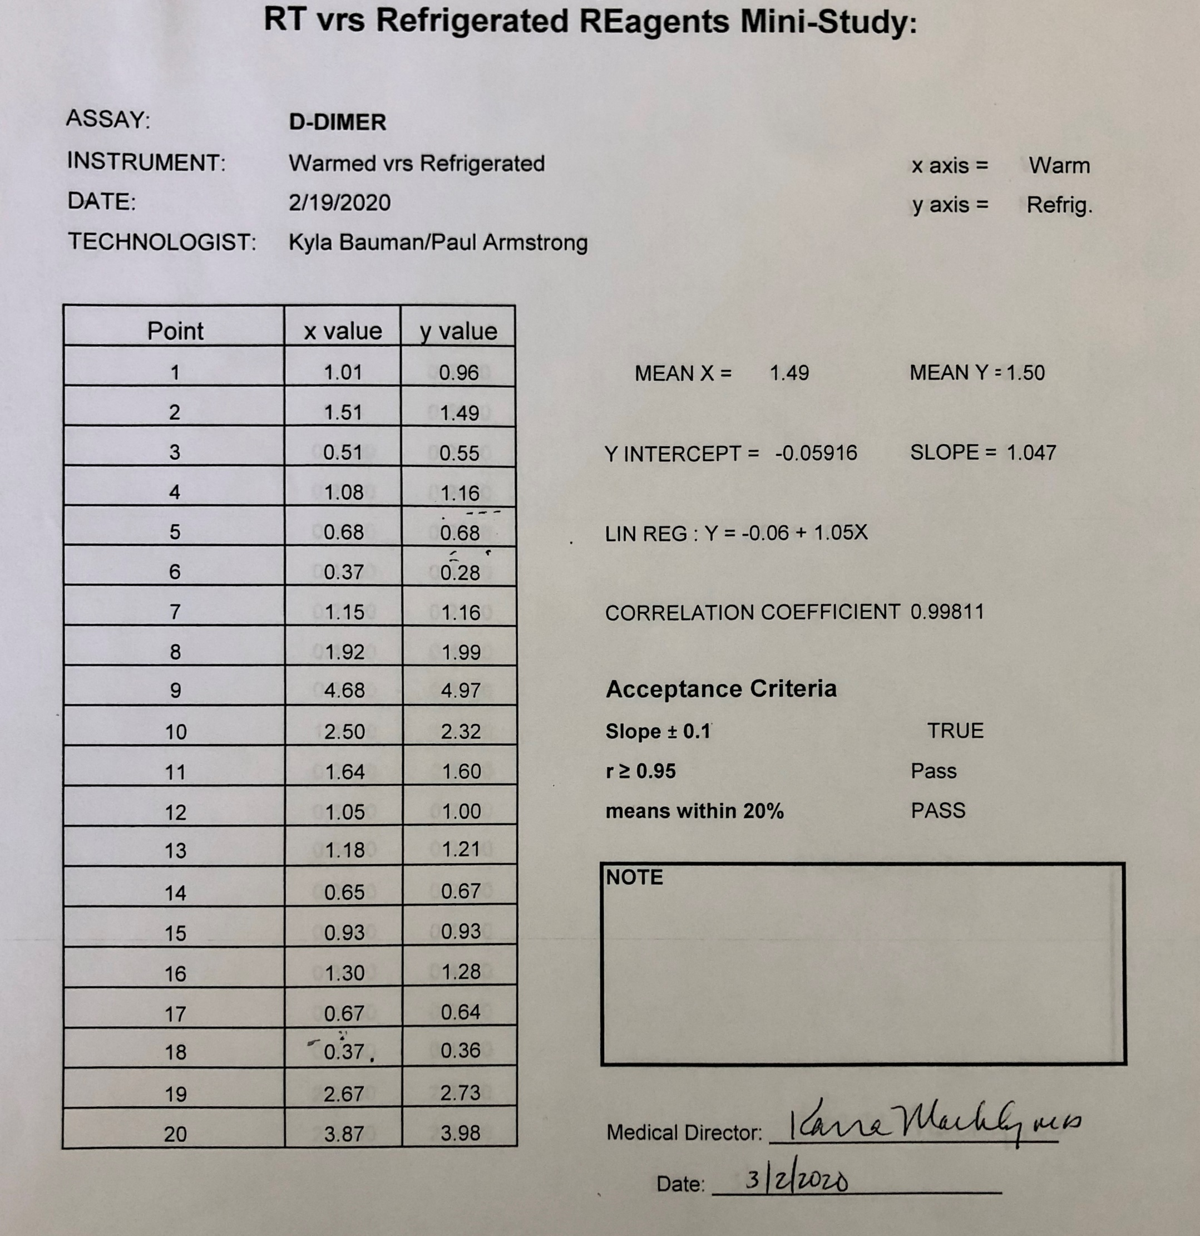

D-Dimer Results
Acceptance Criteria PASSED

Slide 11
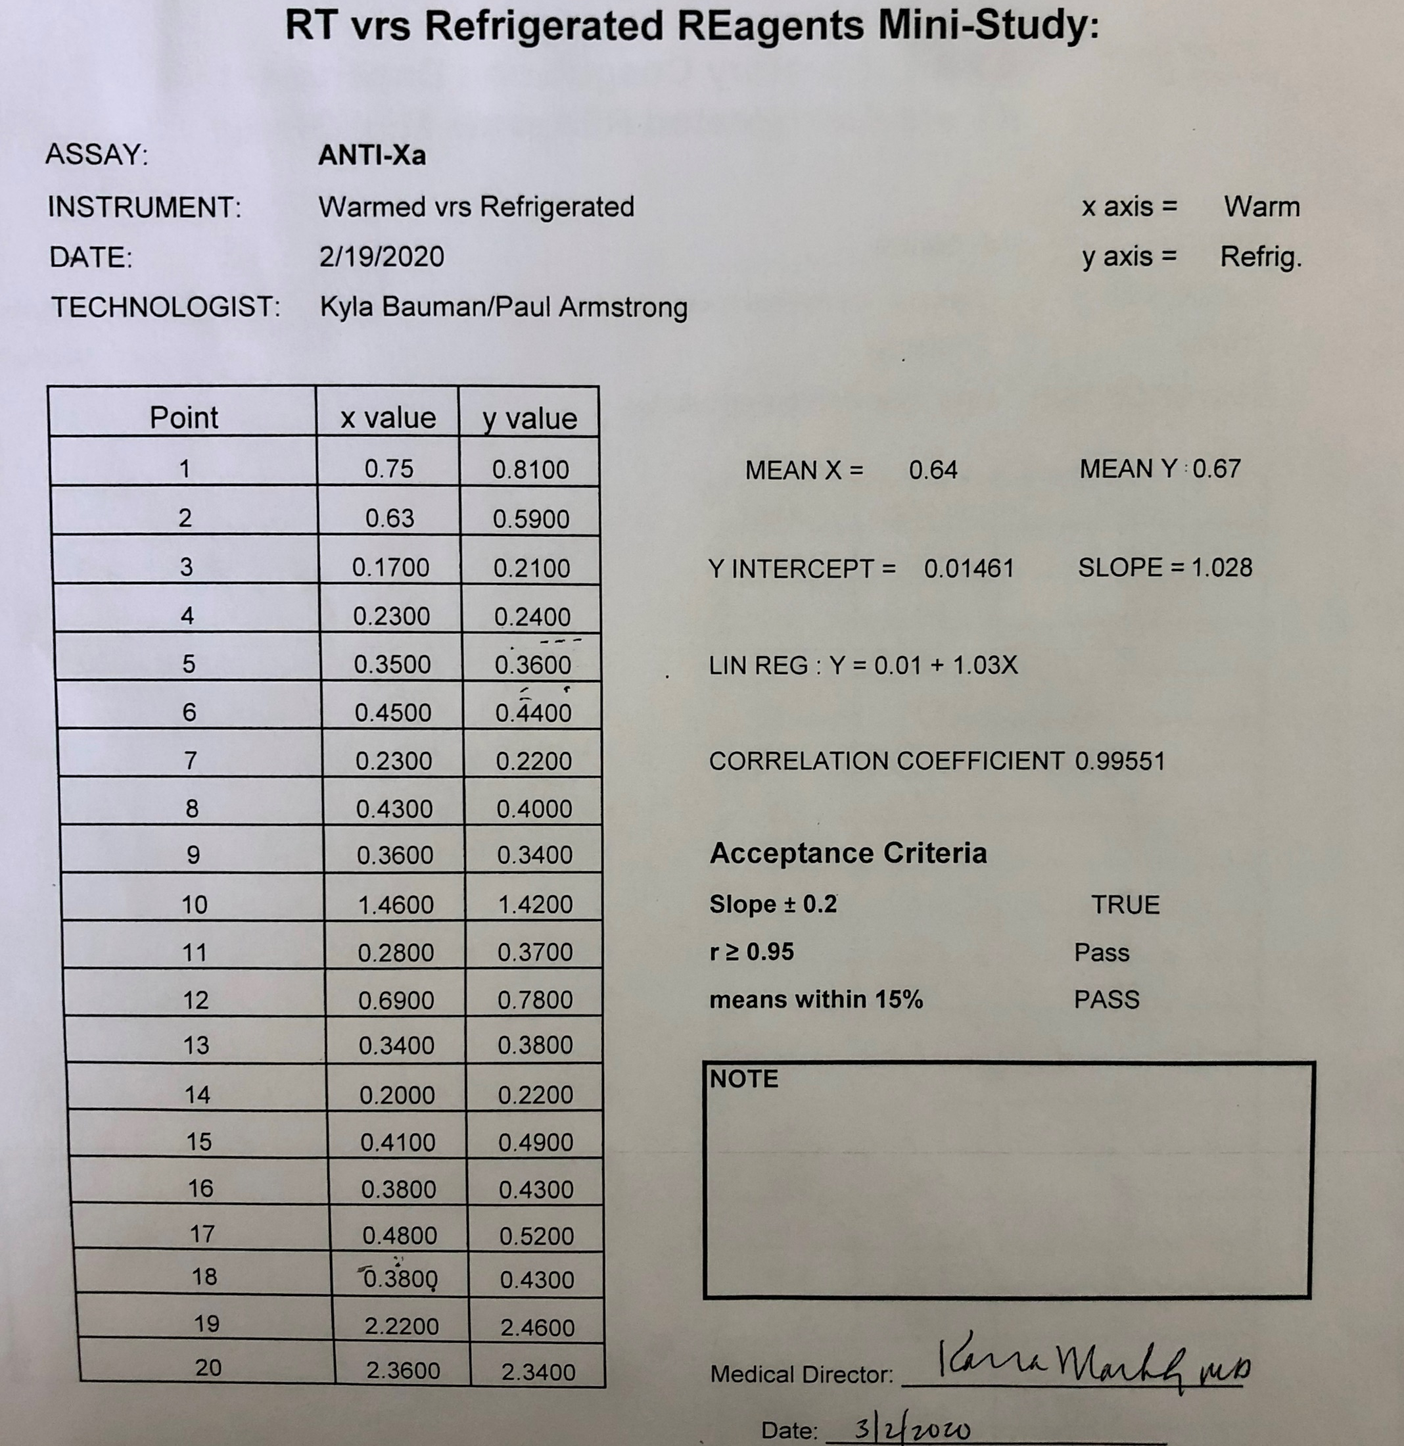

Anti-Xa Results
Acceptance Criteria PASSED

Slide 12
CONCLUSION
Success!
The necessary criteria was met
No clinically significant effect on patient results
Medical Director approval
Improvement of patient care, especially in stat situations
Study Outcome: Stago reagent can be directly loaded onto the analyzer from the refrigerator.

Slide 13

What I Learned
Gained more experience with the analyzer
  Navigating modules
  Troubleshooting QC
Stago Reagents
  Reconstitution
  Stability
Hemostasis reference ranges
Introduction into correlation studies in the clinical laboratory

Slide 14
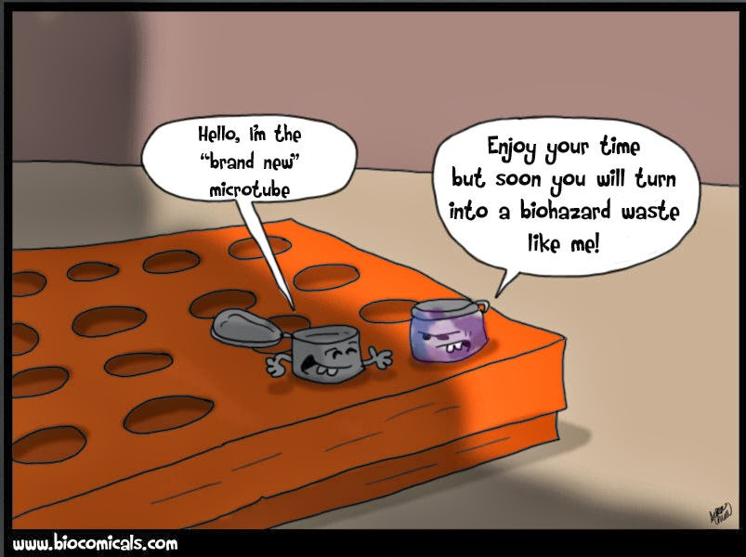
MULTIPLE CHOICE QUESTION
What methodology does the Stago Coagulation Analyzer use to measure PT, PTT, and Fibrinogen?
A) Chromatographic
B) Nephelometric
C) Immunologic
D) Mechanical/Magnetic

